Slide 1
Mobile price classification
By
Soumili Das

Slide 2
Introduction
Nowadays, mobile is one of the most common selling and buying devices.
The main goal of this study is to determine “whether a cell phone with certain features would be inexpensive or expensive.
Everyday , hundreds of thousands of cell phones are sold and bought. As a result , the mobile price class prediction is a case study for the given problem form, finding the best product.

Slide 3
Workflow
Data Analysis
Data description
Exploring the Data
Exploratory Data Analysis
Data cleaning
Train And Split
Finding accuracy score

Slide 4
Data analysis
Cleaning , transforming and modelling data to uncover valuable knowledge for business decision-making is the method of data analysis.
Data analysis is the Goal to derive Valuable knowledge from data and make decisions based on that information.
Systematic approaches are used to search for patterns, groupings or other associations between various types of data.

Slide 5
Data description :-
battery power: Total energy a battery can store in mAh.
• blue: Bluetooth enabled (1 if yes, 0 if no).
• clock_speed: Speed at which microprocessor executes instructions.
• dual_sim: Dual SIM support (1 if yes, 0 if no).
• fc: Front Camera mega pixels.
• four_g: 4G network support (1 if yes, 0 if no).
• int_memory: Internal Memory (in gigabytes).
• m_dep: Mobile Depth in cm.
• mobile_wt: Weight of mobile phone.
• n_cores: Number of cores of the processor.
• pc: Primary Camera mega pixels.
• px_height: Pixel Resolution Height.
• px_width: Pixel Resolution Width.
• ram: Random Access Memory in megabytes.

Slide 6
Data description(contd)
sc_h: Screen Height of mobile in cm.
• sc_w: Screen Width of mobile in cm.
• talk_time: Longest time that a single battery charge will last when you are talking.
• three_g: 3G network support (1 if yes, 0 if no).
• touch_screen: Touch screen support (1 if yes, 0 if no).
• wifi: Wifi connectivity (1 if yes, 0 if no).
• price_range: Price range of the mobile phone (0 - low cost, 1 - medium cost, 2 - high cost, 3 -
very high cost).

Slide 7
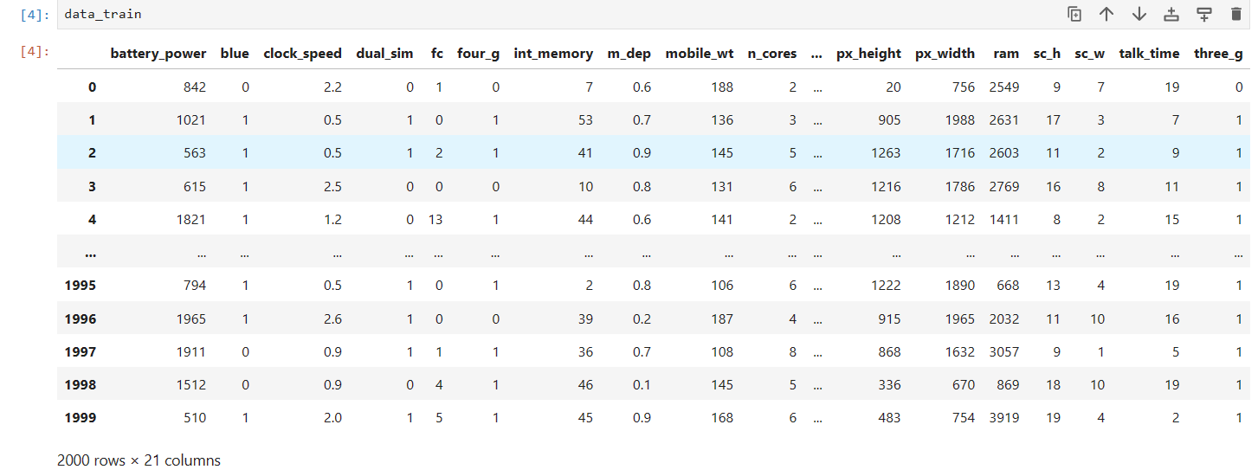
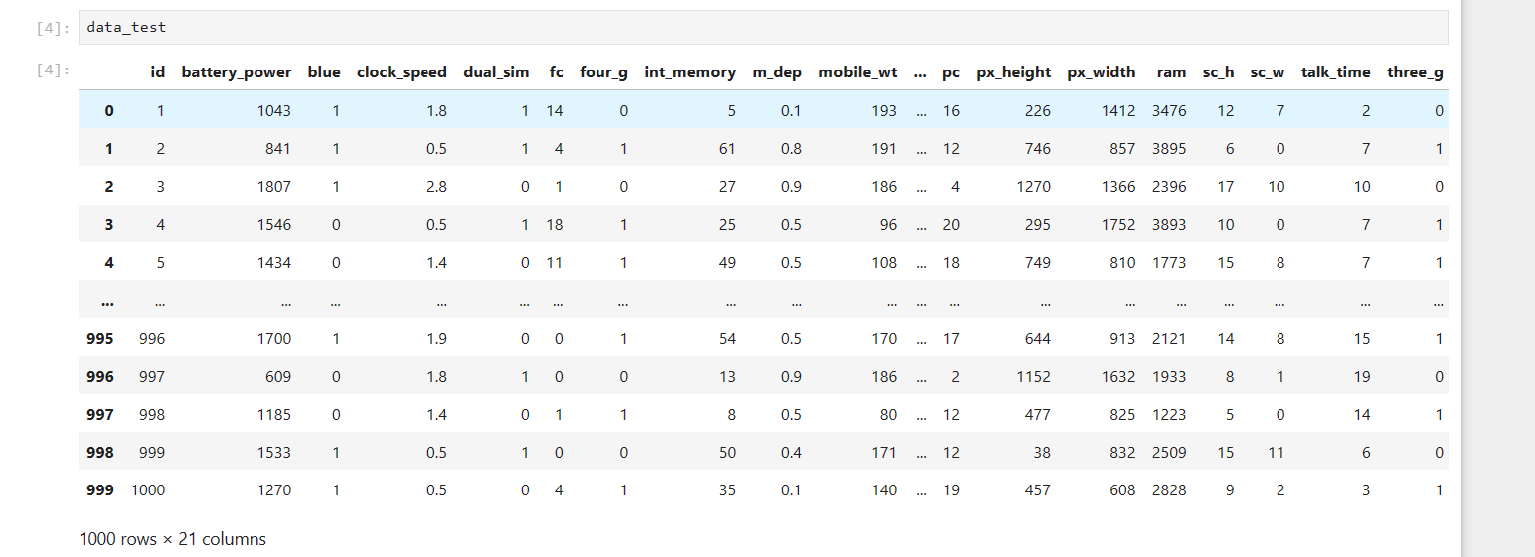
Train dataset contains 2000 rows and 21 columns
Test dataset contains 1000 rows and 21 columns

Slide 8
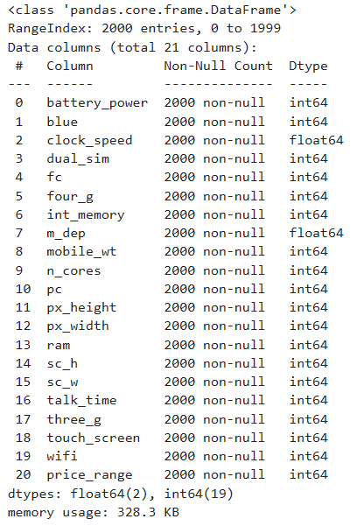
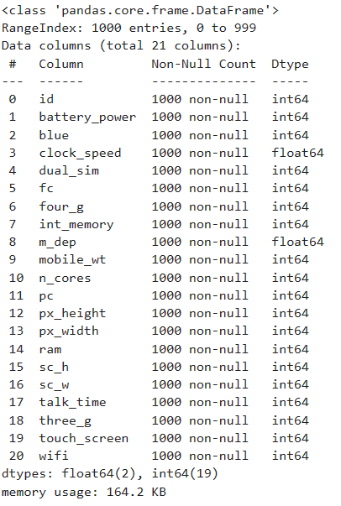
Exploring the data
Then we checked for various null values in order to clean and visualize data.
Train data
Test data

Slide 9
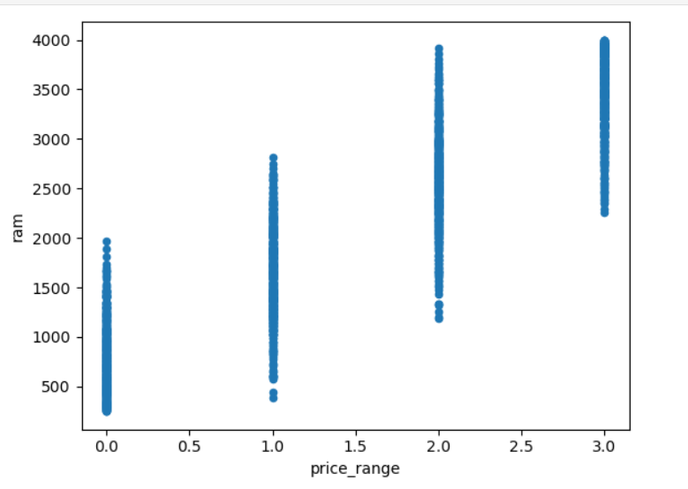
Exploratory data analysis
Let us compare the different features of a mobile
Ram has continuous increase with price range while moving from low cost to very high cost.
Ram vs price range

Slide 10
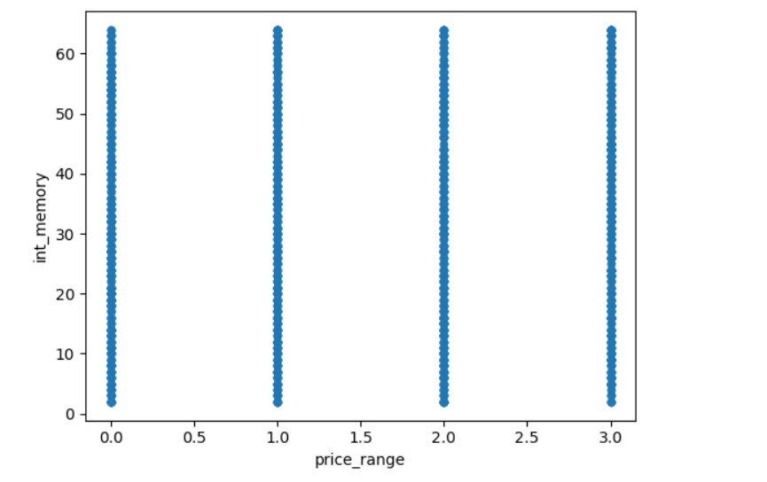
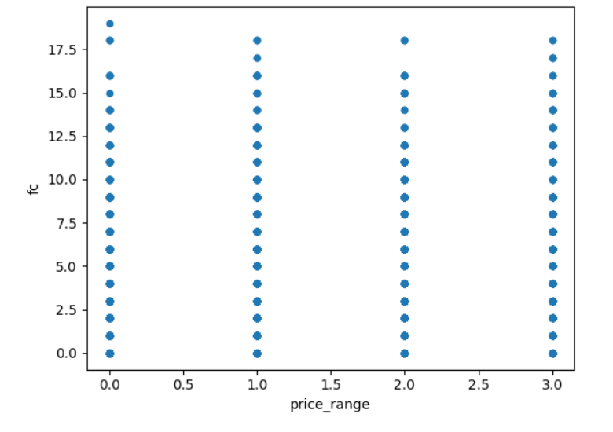
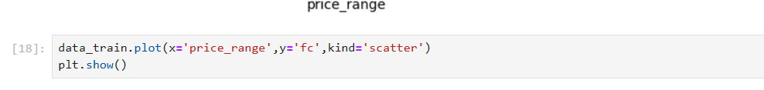
Int_memory vs price range
Front camera vs price_range

Slide 11
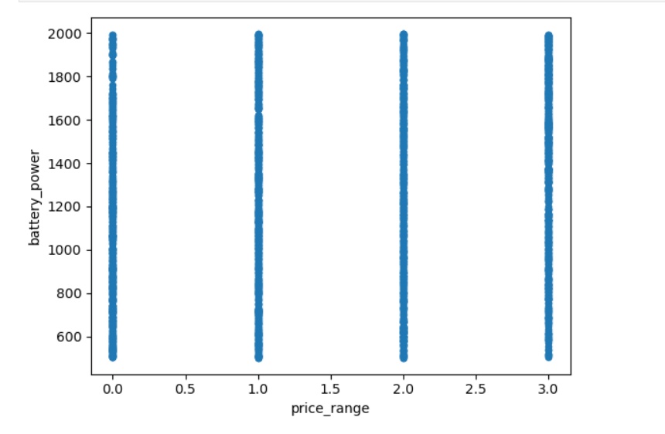
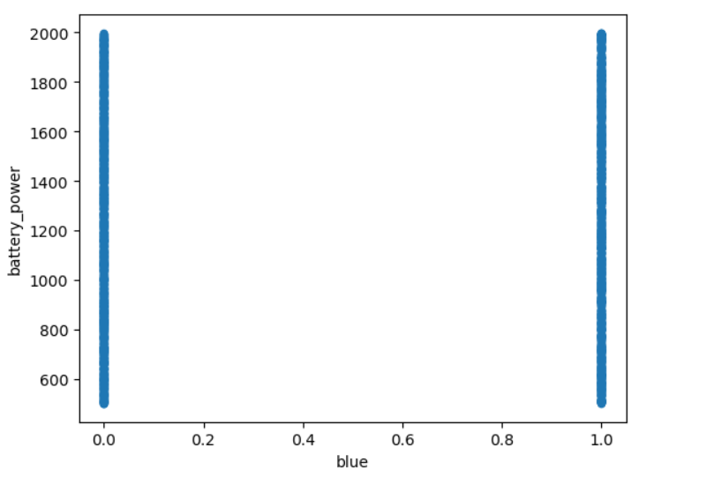


Battery_power vs price_range
Battery_power and Bluetooth

Slide 12
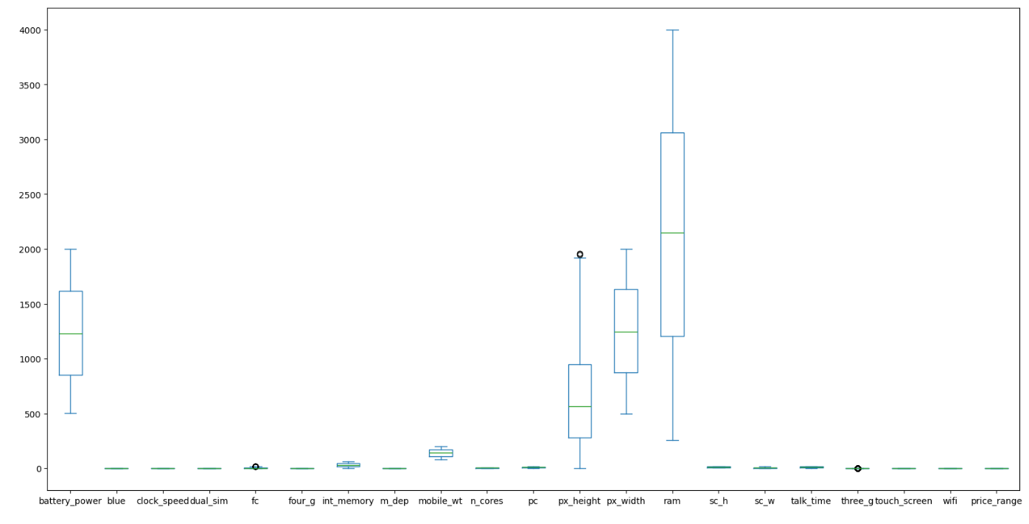
Outliers or heat map
Correlation between various features:-
Our target price range has highly positive correlation between ram.
Also, px_height(Pixel Resolution Height, px_width(Pixel Resolution Width), batter_Power features have highly positive correlations.

Slide 13
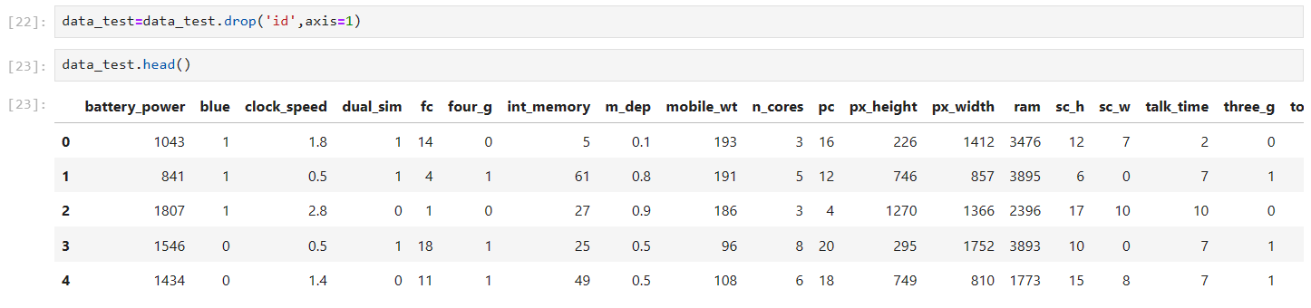
Data cleaning
Data cleaning is the process of finding the parts of data that are incorrect, incomplete, unreliable , irrelevant or absent and then updating , replacing or removing them as required.
Data cleaning is regarded as a fundamental component of data science.
We have dropped the price_range from the data_train and “id” from the data_test.

Slide 14
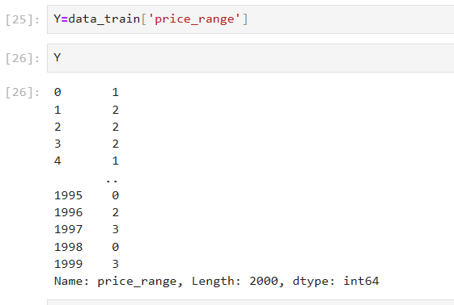
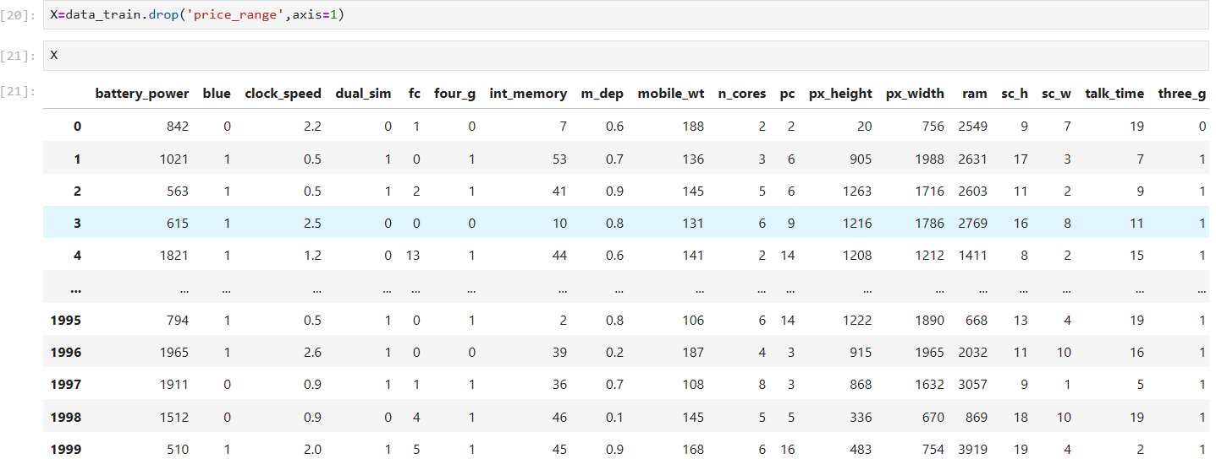
We store the price range of train data in another variable Y
Store the train dataset without the price range in X

Slide 15

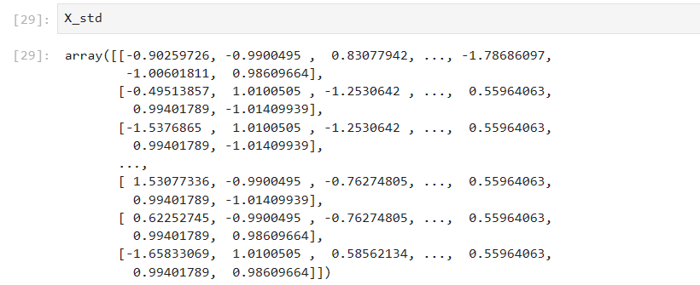
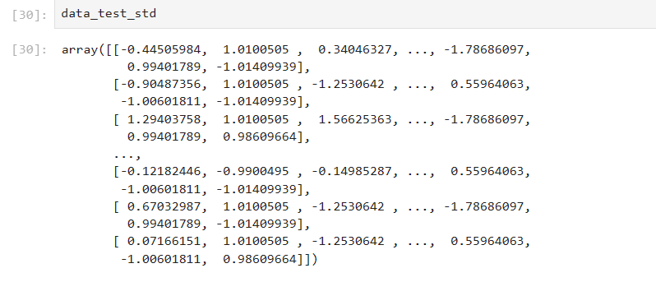
Obtain the standard Forms of the train and test dataset

Slide 16
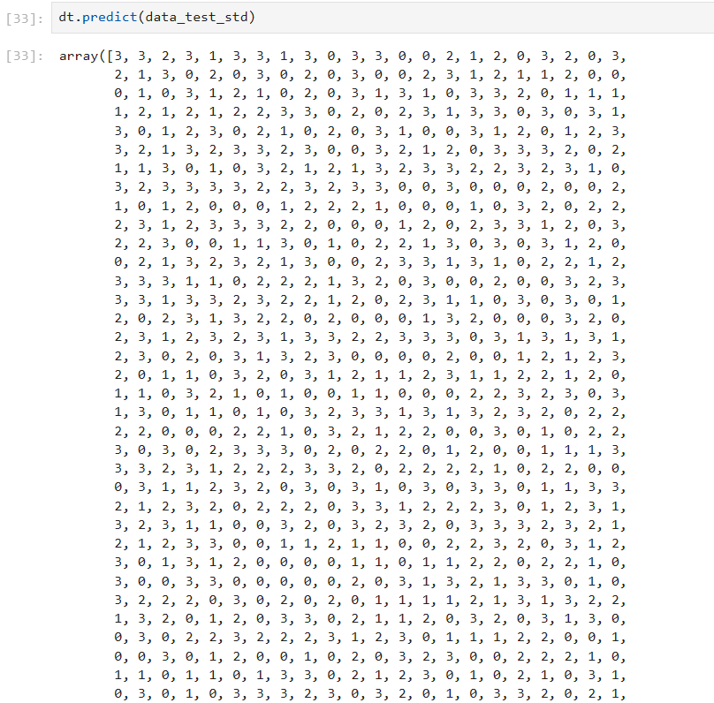

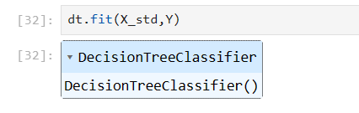

Training the model
Here, we use 3 types of training method :-
Decision Tree

Slide 17
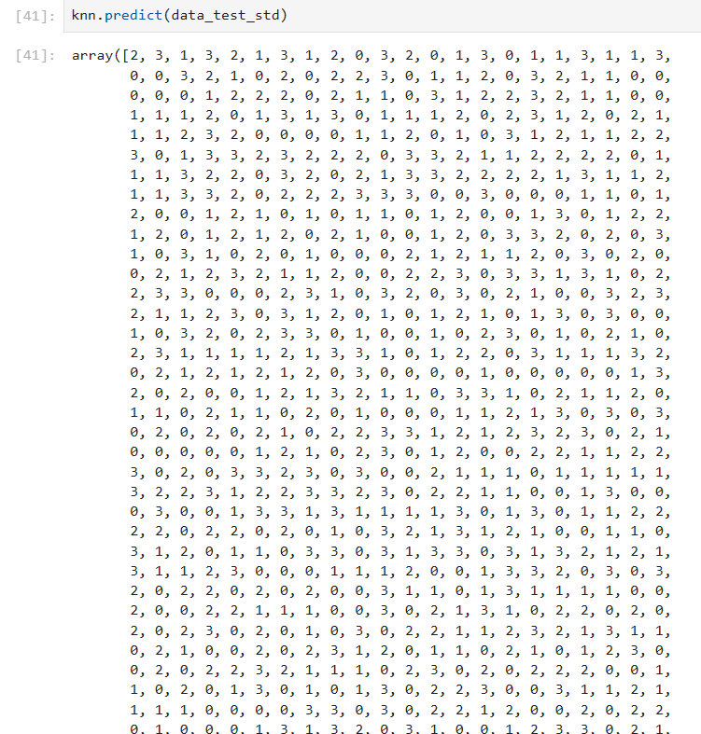

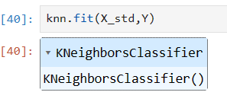
KNN

Slide 18
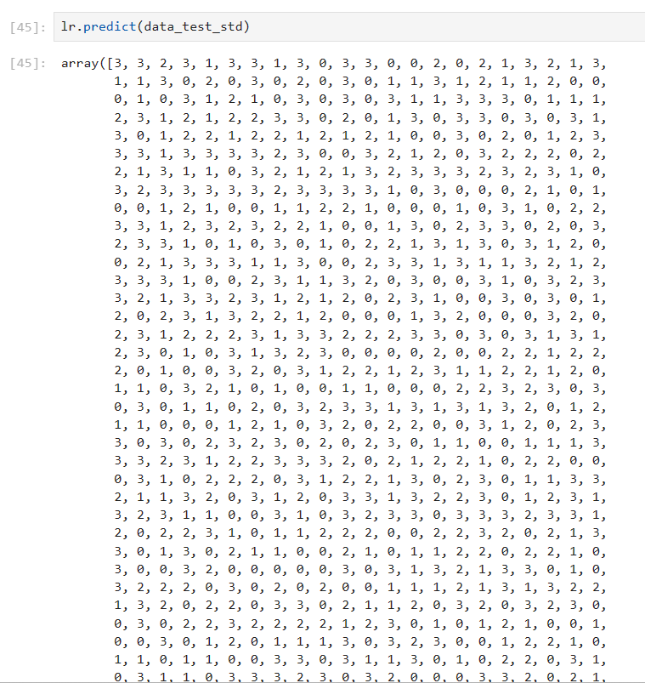

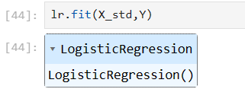
LOGISTIC REGRESSION

Slide 19
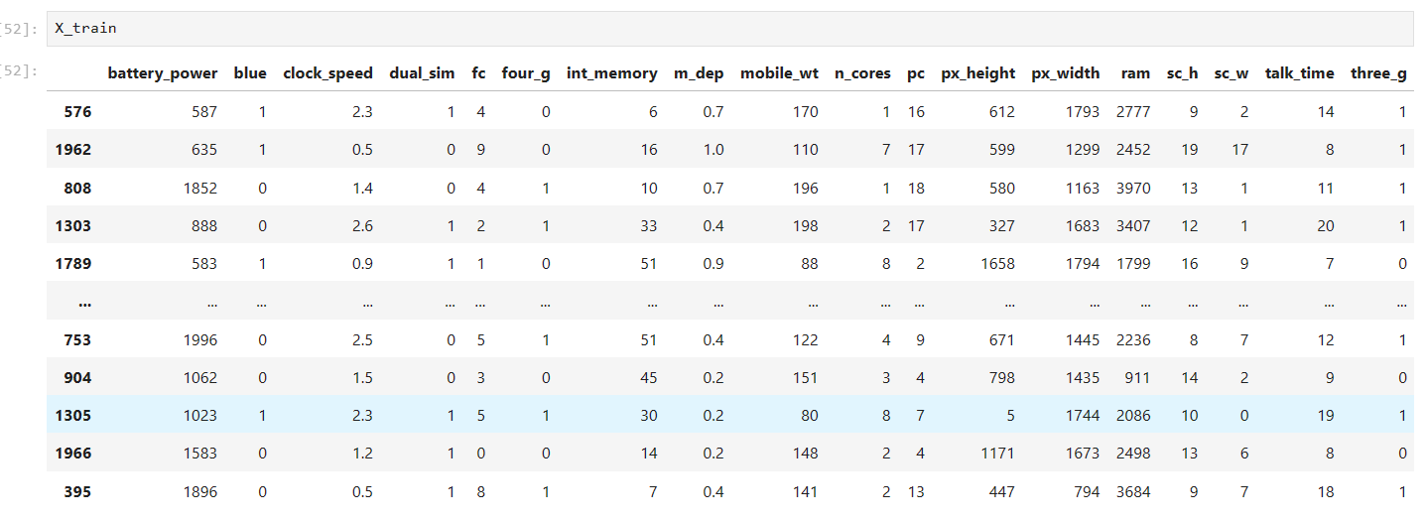
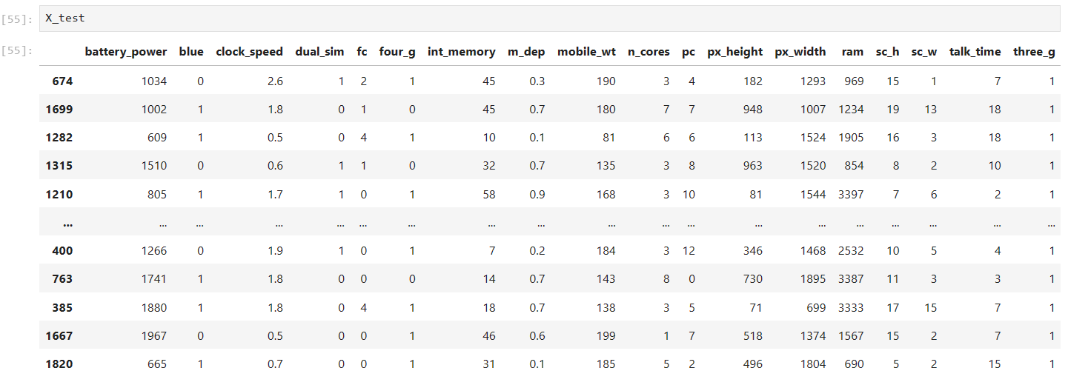
Splitting the data
Now we will use only train.csv and gonna split it into train and test.

Slide 20
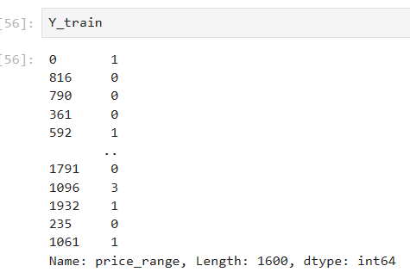
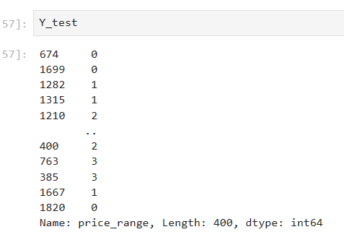
After splitting the Y_test and Y_train.

Slide 21
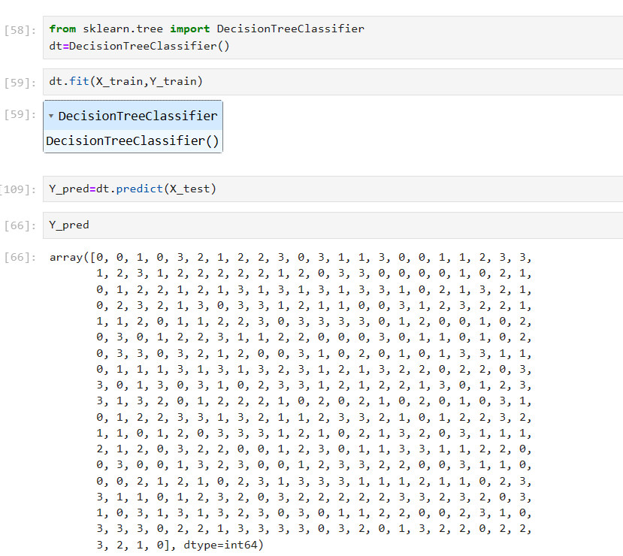
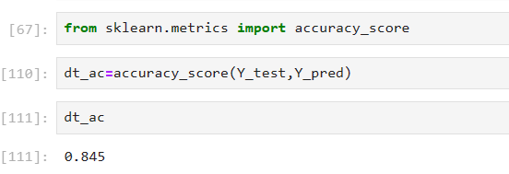
Finding accuracy score
We find the accuracy in three cases
Decision Tree
By following decision tree algorithm , we get 84% accuracy.

Slide 22
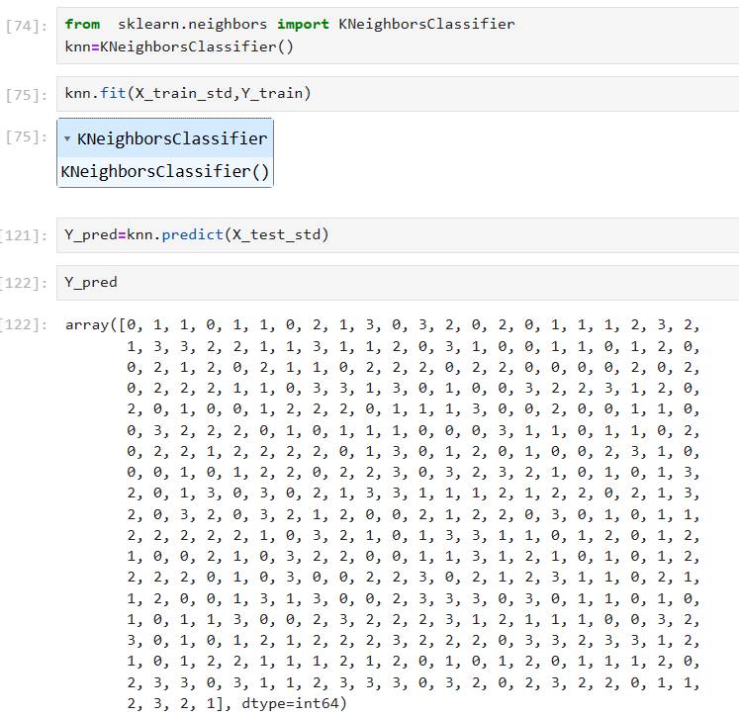
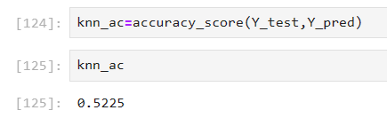
KNN
By following KNN algorithm, we get only an accuracy of 52%.

Slide 23
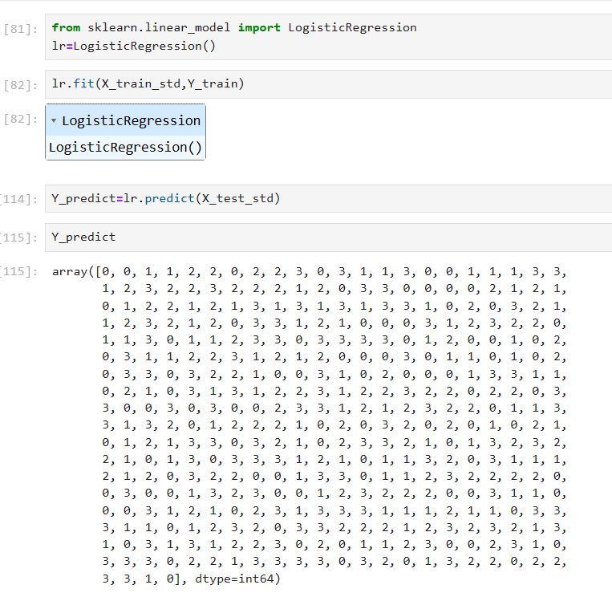
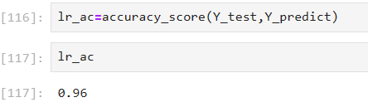
LOGISTIC REGRESSION
By following Logistic Regression, we get accuracy score of 96%.

Slide 24
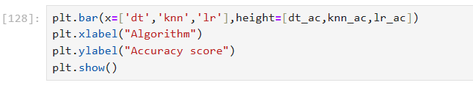
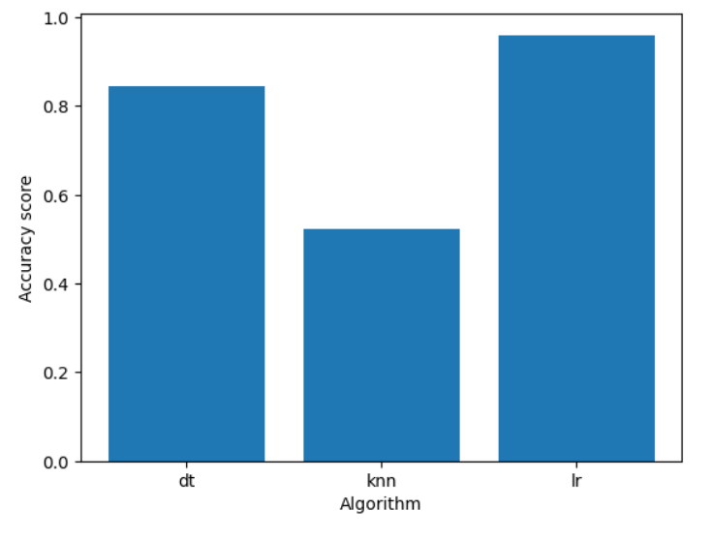
PLOTTING THE ACCURACY

